Slide 1

NGO CSocD GRASSROOTS SURVEY
February 2019
Social Protection at the Grassroots Level
Notes:
This survey was prepared in advance of the 2019 Commission for Social Development by the grassroots sub-committee of the NGO CSocD advocacy committee

Slide 2
Definition
“Social Protection, or social security, is a human right and is defined as the set of policies and programmes designed to reduce and prevent poverty and vulnerability throughout the life cycle. Social protection includes benefits for children and families, maternity, unemployment, employment, injury, sickness, old age, disability, survivors, as well as health protection. Social protection systems address all these policy areas by a mix of contributory schemes (social insurance) and non-contributory tax-financed benefits, including social assistance.”
Notes:
We used the definition of Social Protection put forth by the ILO in their 2017-2019 report. This definition presents social protection as a human right

Slide 3
The Approach
A life-cycle approach was used to focus the questions on:
  Universal Healthcare
  Social Protection for Children
  Social Protection for Women and Men of Working Age
  Maternal Healthcare
  Workers Compensation and Disability
  Social Protection for Older Women and Older Men
  Pensions
  Long Term Care
Notes:
As presented in the ILO definition of social protection, a life-cycle approach was used and covered, universal healthcare, children, women and men of working age, and older women and men.

Slide 4
Background
The survey’s aim was to determine the existence of social protection programs as experienced at the grassroots level and to question the factors that influence satisfaction with the programs available
Over 200 respondents in 28 countries
Notes:
Our intent was to give voice to those who do not usually speak at the commissions – the grassroots organizations that work day to day with those in need.
There were over 200 respondents in 28 countries both developed and developing. Half of the responses were from organizations in North America (Mostly USA but some Canada).

Slide 5

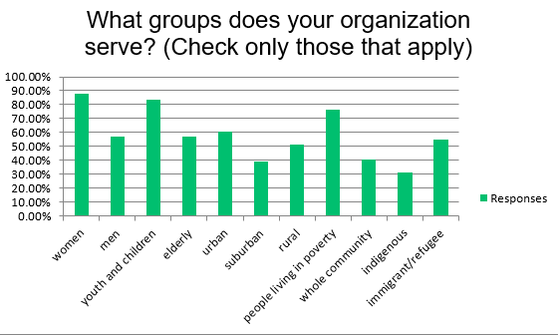
Notes:
We asked which groups were served by the responding organizations. In fact almost half of the responding organizations served all four groups: women, men, youth and children, and the elderly (first 4 bars on the left). As for geography, there was a good representation of organizations working in urban, suburban, and rural areas. And, over 70% of respondents indicated that they worked with people living in poverty. The take away is that poverty isn’t just an urban or rural issue. It’s everywhere. You can also see that these organizations work with the indigenous and immigrant/refugee populations which is consistent with people living in poverty (last 2 bars on the right).

Slide 6
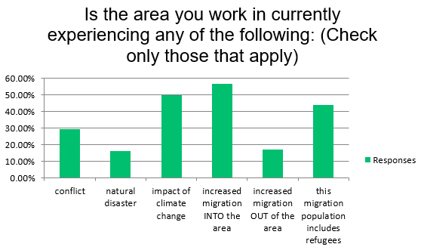
Notes:
These organizations are predominantly dealing with immigration issues (including refugees) and the impact of climate change.

Slide 7
Universal Healthcare
“Health protection, both direct and indirect, is essential for achieving most of the Sustainable Development Goals (SDGs). An enabling framework providing legal health coverage, sufficient public funding and an adequate supply of health workers enjoying good working conditions to provide quality services, has the potential to reduce mortality and increase the health status of the population (WHO, 2017).”
Notes:
The first area we explored was healthcare

Slide 8

Where do members of the community go for healthcare:
Over 70% said public or government funded clinics and hospitals
50% said public or government funded doctors
30% said private insurance clinic/hospital/doctor
9% said no healthcare available
Notes:
When we asked: “Where do members of the community go for healthcare?” Most respondents indicated that healthcare is provided by facilities paid for by the government. It includes prenatal, maternity, emergency care, preventive care, vaccinations, routine checkups, well baby care, surgery and AIDs treatment.

Slide 9
Overall, how would you rank the quality of healthcare in the community served by your organization?
64% of respondents said good to excellent
18% said average
18% said fair to poor
Notes:
When we asked about the quality of healthcare we saw that 81% said average or better. So, if there is availability and decent quality of care, what are the issues

Slide 10
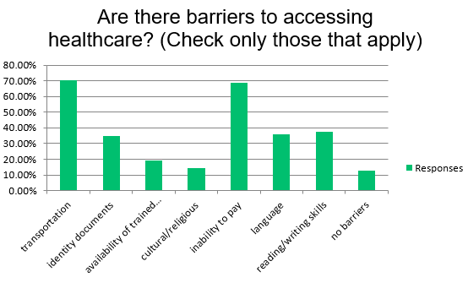
Notes:
We would have expected inability to pay to be a barrier but were surprised that transportation was also a significant barrier. This was true whether in an urban, suburban, or rural area. Quality of healthcare services wasn’t the dominant issue as 81% of respondents said is was average or better. The takeaway is that having healthcare services is the beginning, not the end. There must be access to those services.

Slide 11
Social Protection for Children
“For children, lack of access to adequate nutrition, education, and healthy environments is particularly harmful, with the consequences of irreversible damage to their mental and physical development and well-being.”
Notes:
We turned next to social protection for children.

Slide 12
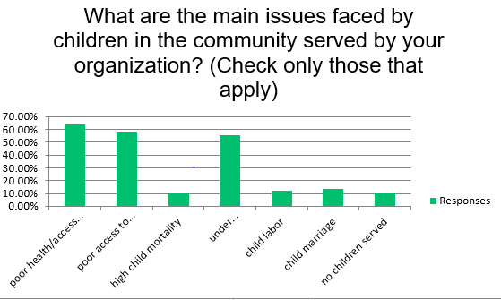
Notes:
And we asked about the issues facing them. Access to healthcare services, access to education and under nutrition/malnutrition were the dominant issues for children. These are mostly addressed by free school food and other food programs as well as free education. Fewer than 10% of respondents said there were any kinds of cash transfer programs.

Slide 13
Overall, how would you rank the social protection benefits for children in your community?
53% of respondents said good to excellent
25% said average
22% said fair to poor
Notes:
When asked to rank social protection benefits for children, 77% responded average or better.

Slide 14
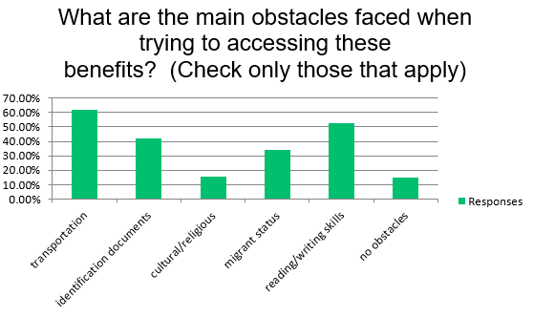
Notes:
When asked about obstacles, we see, as with healthcare, transportation is a substantial barrier. Other obstacles are related to the immigrant populations, identity document, reading/writing skills. There were comments that people don’t know about the programs offered or how to apply for them.

Slide 15
Social Protection for Men and Women of Working Age
“Social protection plays a key role in ensuring income security for women and men of working age, which is an essential component of the well-being of individuals and families, and for the achievement of the Sustainable Development Goals.”
Notes:
The next segment in the life cycle approach is men and women of working age

Slide 16
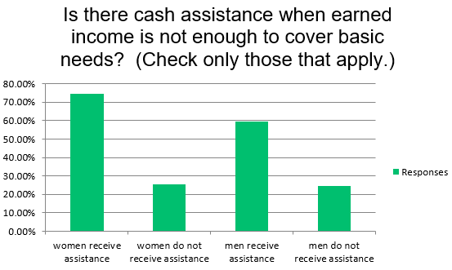
Notes:
We asked about cash assistance. During periods of unemployment, 25% of the respondents said there was no protection for men or women during unemployment. Also, (not seen on this chart) 45% said there was no assistance if someone fell ill and couldn’t work temporarily.

Slide 17
Overall, how would you rank the social protection for women and men of working age in your community?
38% of respondents said good to excellent
25% said average
38% said fair to poor
Notes:
Given the absence of benefits, it isn’t surprising that 63% rank it average or above, and a much larger number said fair to poor than rankings for healthcare and children

Slide 18
Maternal Healthcare
“Another fundamental component of universal health care is maternal health care, namely effective access to adequate medical care and services during pregnancy, childbirth and beyond, to ensure the health of both mothers and children.”
Notes:
Maternal healthcare is an important part of the life cycle.
With regard to maternity care, 91% of respondents said there was access to pre-natal care and medical facilities for childbirth—usually in a hospital. As for paid leave…

Slide 19
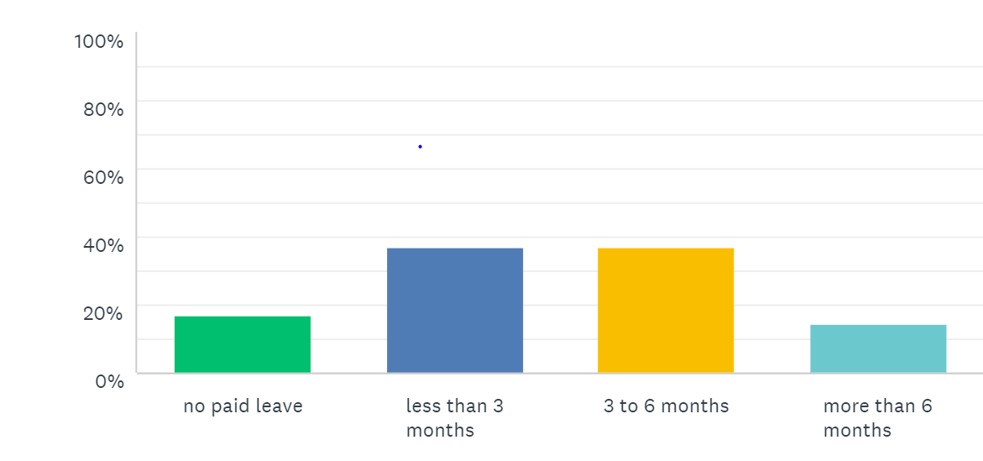
How long is maternity paid leave?
Notes:
83% said there is paid maternity leave most commonly less than 3 months or 3 – 6 months.

Slide 20
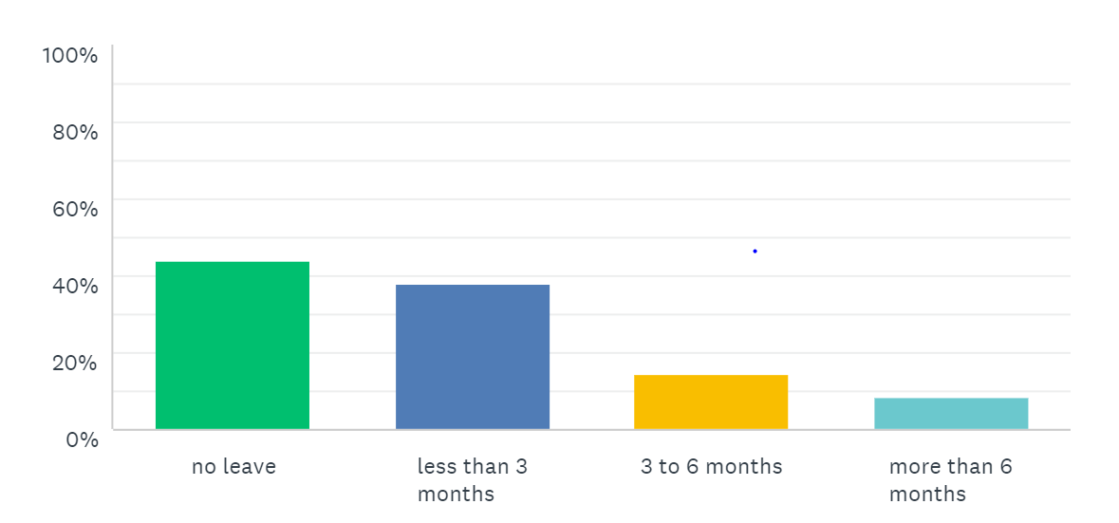
How long is paternity paid leave?
Notes:
Paternity leave was less common with only 32% saying there was paid paternity leave usually less than 3 months.

Slide 21
Overall, how would you rank the quality of maternal care in your community?
60% of the respondents said good to excellent
20 % said average
20% said fair to poor
Notes:
When asked to rank the quality of maternal care in the community, we see that 80% rank it average or above.

Slide 22
Workers Compensation and Disability
“By ensuring income security in the event of unemployment, employment injury, disability, sickness and maternity, as well as sufficient earnings or other needs, social protection systems support women, men and their families in coping with the financial consequences of life events, to find and sustain decent and productive employment and facilitate effective access to healthcare and other services.”
Notes:
We found that working conditions were not an issue and there are government payments for permanently disability (as opposed to temporary), however….

Slide 23
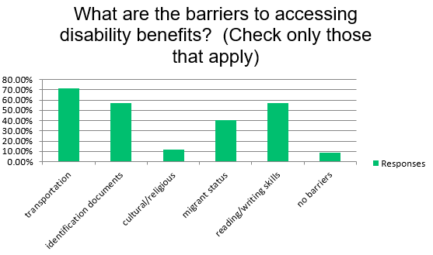
Notes:
We see the same barriers here– transportation, identity documents, and reading/writing skills.

Slide 24
Overall, how would you rank the quality of workers compensation and disability protection in your community?
36% of the respondents said good to excellent
30% said average
34% said fair to poor
Notes:
So, as with rankings for men and women of working age, the fair to poor rankings were higher than for healthcare and children

Slide 25
SocialProtection for Older Women and Older Men
“Insuring income security for people ensuring their old age is a crucial objective among the welfare goals that modern societies seek to realize. Throughout their working life, when most people enjoy good health and productive capacity, they contribute to national development and progress, so it would seem fair that once they get older they are not left behind and that prosperity is shared with them.”
Notes:
Last but not least, we looked at social protection for older persons

Slide 26
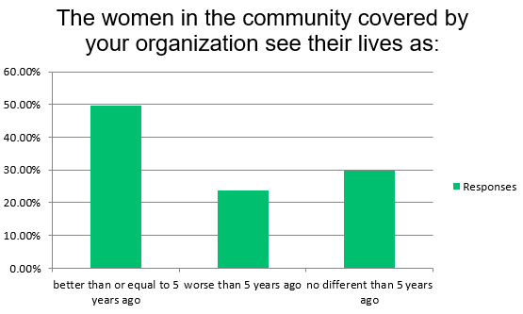
Notes:
24% of the respondents said the women in their communities see their lives as worse a than 5 years ago (middle bar), this is similar,

Slide 27
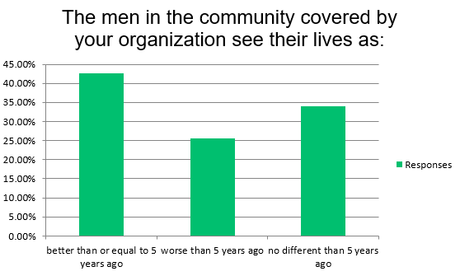
Notes:
to how they say men see their lives (middle bar).

Slide 28
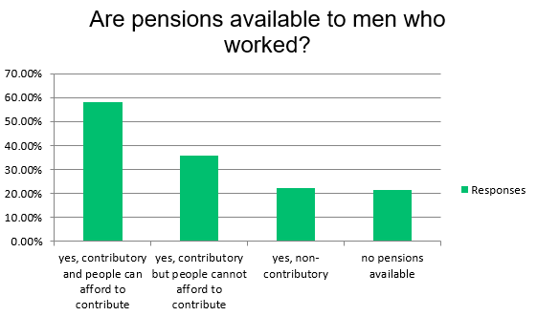
Notes:
Pensions are critical to this older population. 58% of respondents said there are pensions available to men who worked and they can afford to contribute, but 35% said they cannot afford it. 21% of respondents said there are no pensions available.

Slide 29
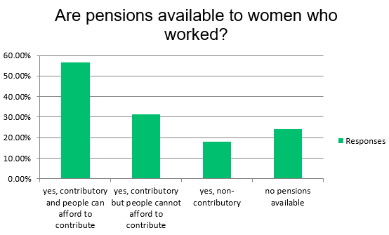
Notes:
57% of respondents said there are contributory pensions for women who worked and they can afford to contribute, but 31% cannot. 24% of respondents said there were no pensions available.

Slide 30
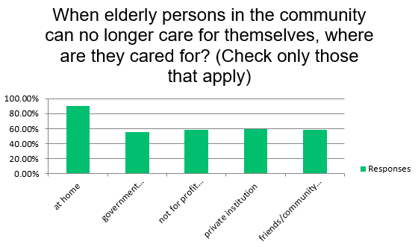
Notes:
We then asked about long term care. Most respondents indicated many non-government means as well as the government.

Slide 31
Overall, how would you rank the adequacy of available pensions?
26% of the respondents said good to excellent
32% said average
42% said fair to poor
Notes:
When asked to rank the adequacy of pensions, we see that this is the highest % of rankings in the fair to poor category.

Slide 32
Take-Aways
What do you think?

